Slide 1

Conference Booking System: CONFERA
22PMC121
DEV NAND NAIR

Slide 2
ABSTRACT
The conference management system is a web-based platform designed to streamline the process of organizing and attending conferences. It provides users with features such as conference listings, online registration and booking, venue management, payment integration, and user profile management. The system aims to simplify the conference management workflow, enhance user experience, and improve overall efficiency. By automating tasks and providing convenient tools, the system facilitates seamless communication, efficient resource allocation, and easy access to conference information. With its user-friendly interface and comprehensive functionalities, the conference management system offers a centralized platform for organizers and attendees to efficiently manage and participate in conferences.

Slide 3
PROJECT REQUIREMENTS
User registration login and logout fuctionalities
Conference listings and management
Online registration and booking for conferences
Venue management for conferences
Integration of payment system for conference bookings
User profile to view booking history and conference venue details
Admin panel for system management and control
Responsive design for seamless access on various devices
Implementation of security measures to protect user data
Testing and quality assurance for bug-free performance

Slide 4
FEATURES AND HIGHLIGHTS
User can register and login to the system
User can search venues based on state and city
User can book the venue and do the payment online
User can view the booking history in the user profile
User can contact the event management team through the contact details which is provided
Admin users can log into the admin panel and they can:
Users can logout of the system
Website has a user friendly and responsive user interface
Add users and conference venues
Modify user’s details and conference details
Delete users and conferences
Manage availability of venues

Slide 5
TECHNICAL ASPECTS
PRESENTATION LAYER
APPLICATION LAYER
•User Interface (UI): This layer includes the components that interact with users, such as web pages or mobile app screens.
•Django Templates: Django's built-in template engine allows you to define HTML templates that render dynamic content and interact with the back-end.
•Jazzmin package: Jazzmin provides a very interactive Django admin panel GUI
•Django: Django serves as the back-end framework, handling HTTP requests, routing, and managing the application's business logic.
•Django Views: Views receive requests from the user interface, process data, and generate appropriate responses. They interact with models, services, and external APIs as needed.

Slide 6
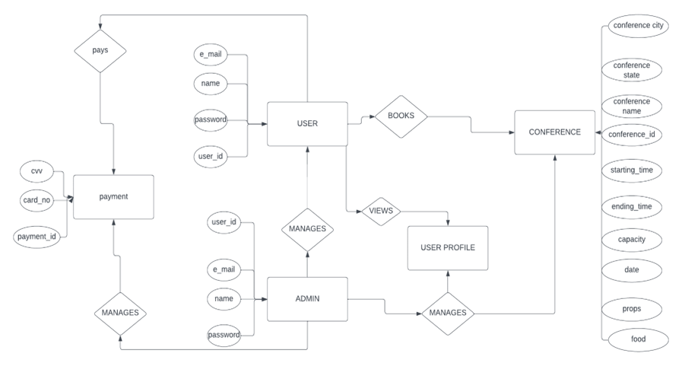
ER DIAGRAM OF DATABASE

Slide 7
CHALLEGES FACED DURING DEVOLOPMENT
Developing a conference management system with login registration, conference booking, venue searching, payment, user profile, and an admin panel using Django can be challenging for beginners. Some key challenges include authentication, implementing booking and searching features, integrating payment systems, managing user profiles, building an admin panel, testing and validation, ensuring scalability and performance, maintaining security, focusing on user experience, and handling maintenance and upgrades. However, by following Django's documentation, breaking tasks into smaller steps, and seeking help from online resources, beginners can overcome these challenges and gain valuable experience in the process.

Slide 8
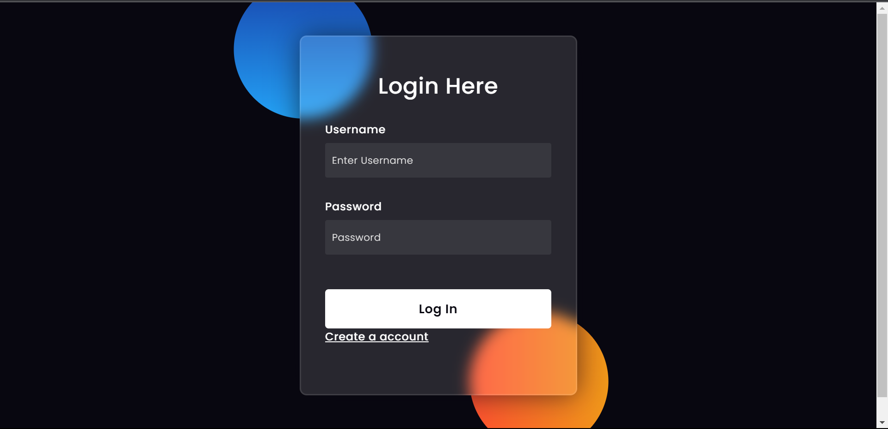
LOGIN PAGE

Slide 9
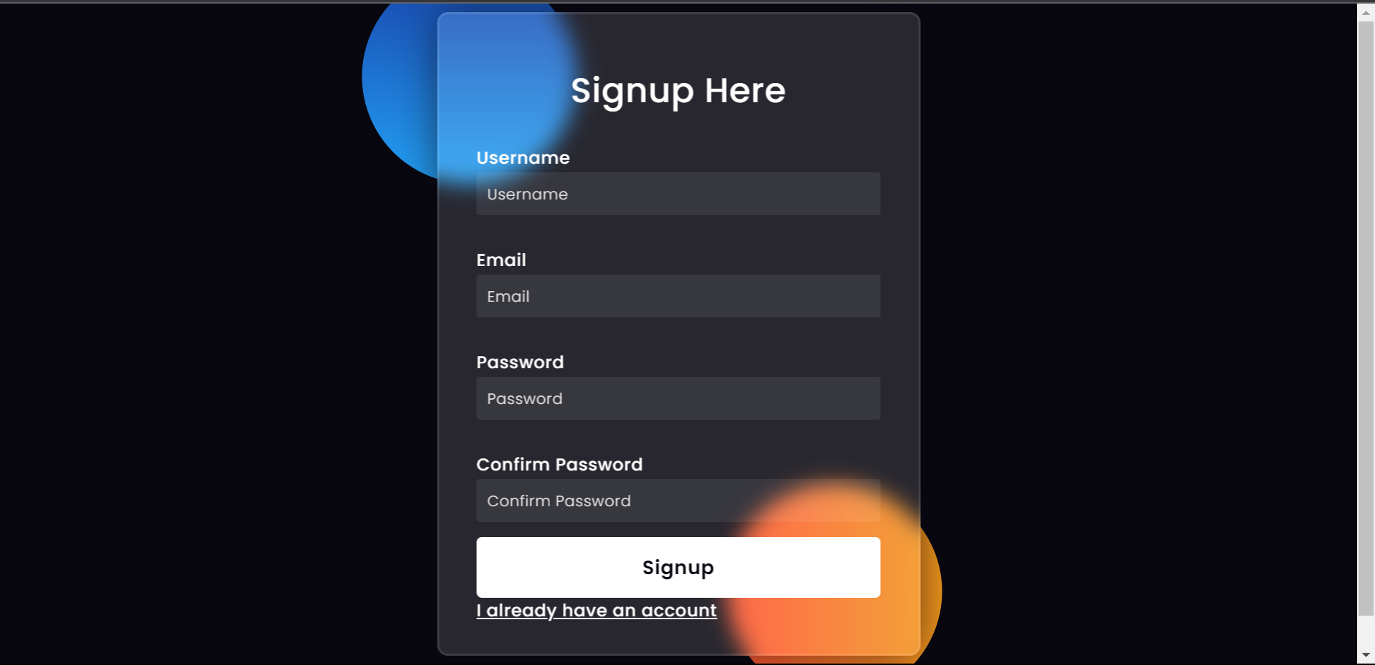
REGISTRATION PAGE

Slide 10
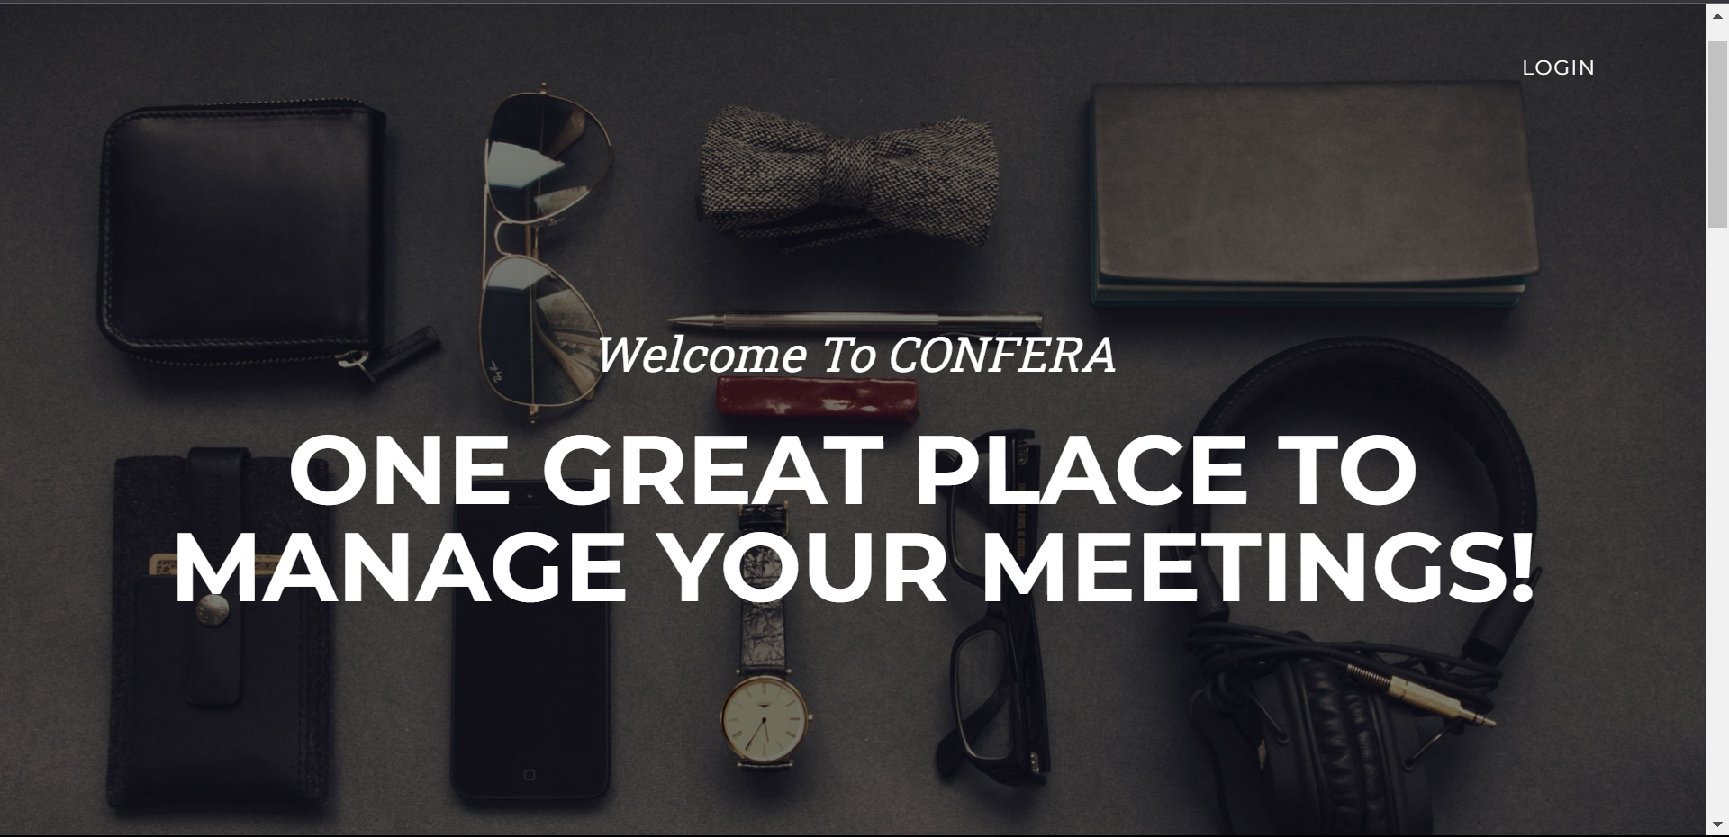
HOME PAGE

Slide 11
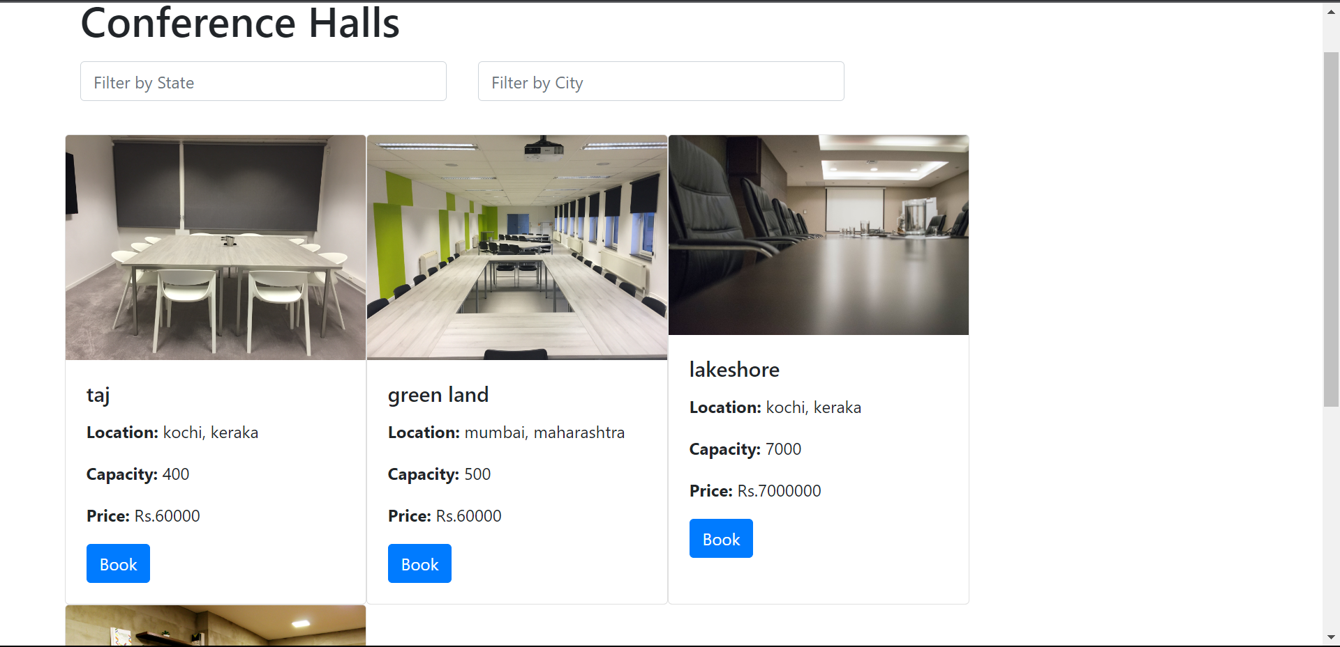
CONFERENCE VENUE LIST

Slide 12
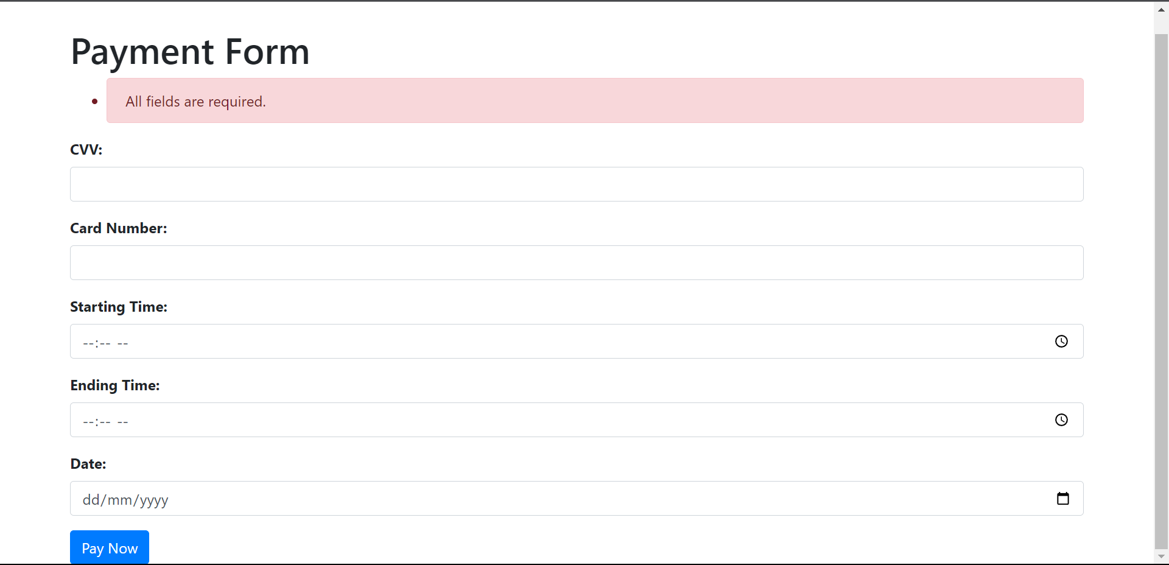
PAYMENT PAGE

Slide 13
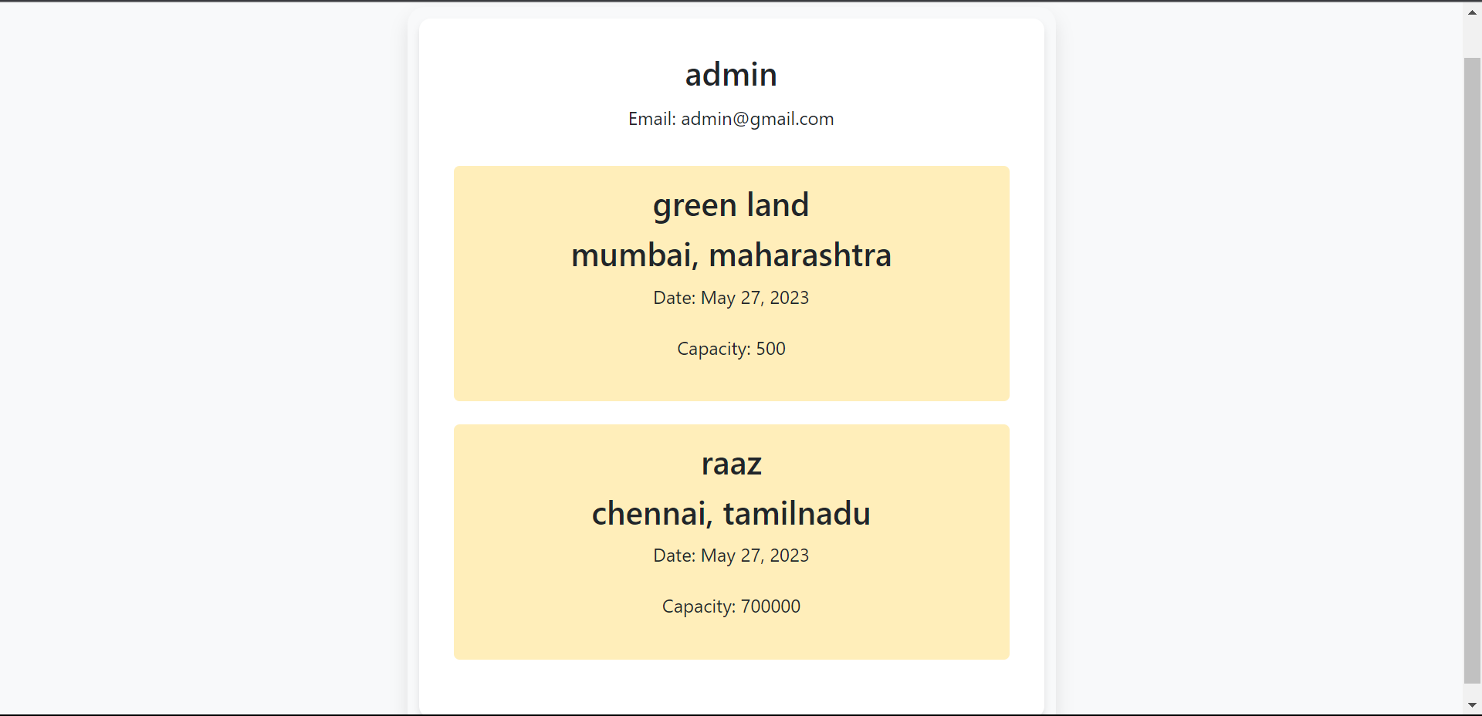
USER PROFILE

Slide 14
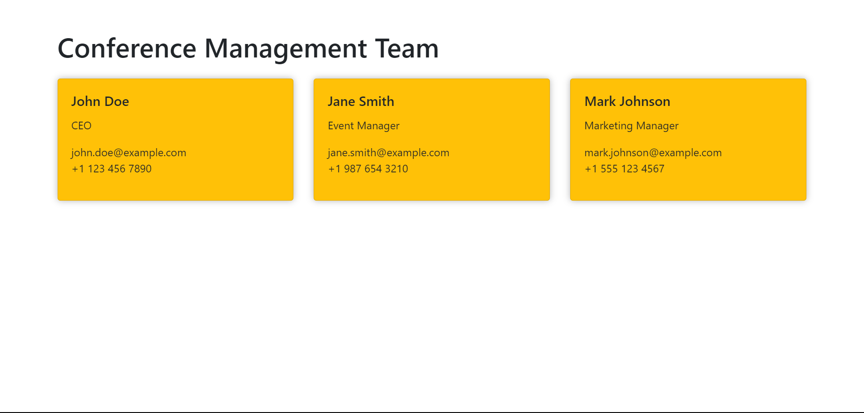
CONTACT DETAILS

Slide 15
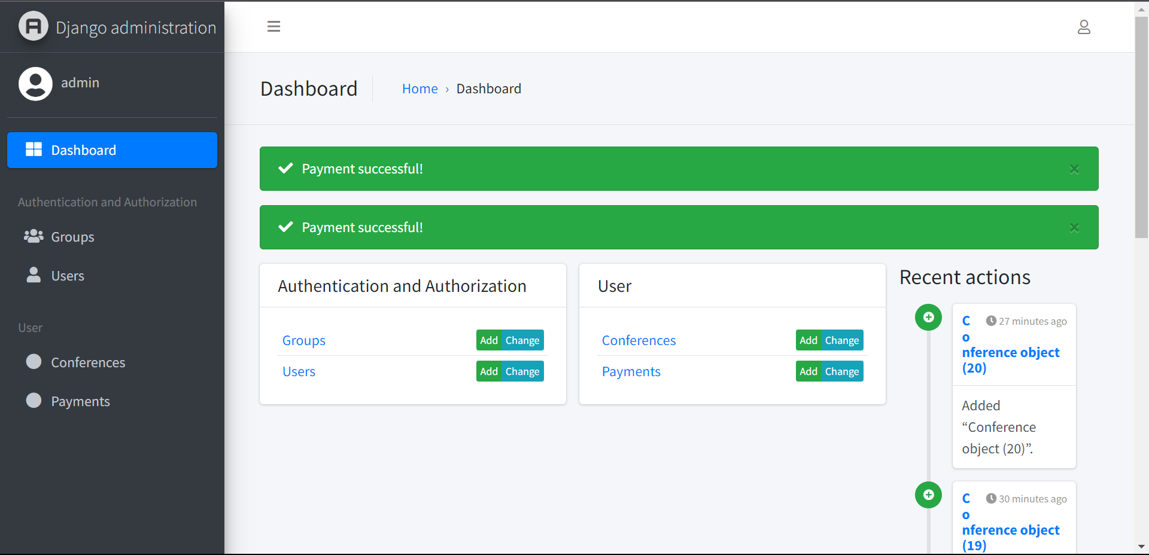
CONTACT DETAILS

Slide 16
THANK YOU

